Slide 1
The Spirituality within Psychodrama Dena Baumgartner, Ph.D., TEP, LMFT, LPC, CGP USA
Dena Baumgartner, Ph.D., TEP, LMFT, LPC, CGP
November 16, 2017

Slide 2
Psychodrama Parents
J.L. Moreno
Zerka Moreno

Slide 4
Psychodrama
Psychodrama is a method of psychotherapy in which a person enacts the problems and relevant events in their life instead of just talking about them. This method integrates cognitive analysis with experimental and participatory involvement. Psychodrama was originated by Jacob L. Moreno, M.D., in 1921. His philosophy was based on the vitalizing force of spontaneity and creativity in action methods in therapy. Spontaneity, along with other methods he developed, were valuable contributions to psychology, sociology, and philosophy. Moreno identified five basic elements in classical psychodrama: the protagonist, the director, the auxiliary, the audience, and the stage.

Slide 5
Awe
The feeling of being in the presence of something vast or beyond human scale that transcends our current understanding of things.

Slide 7
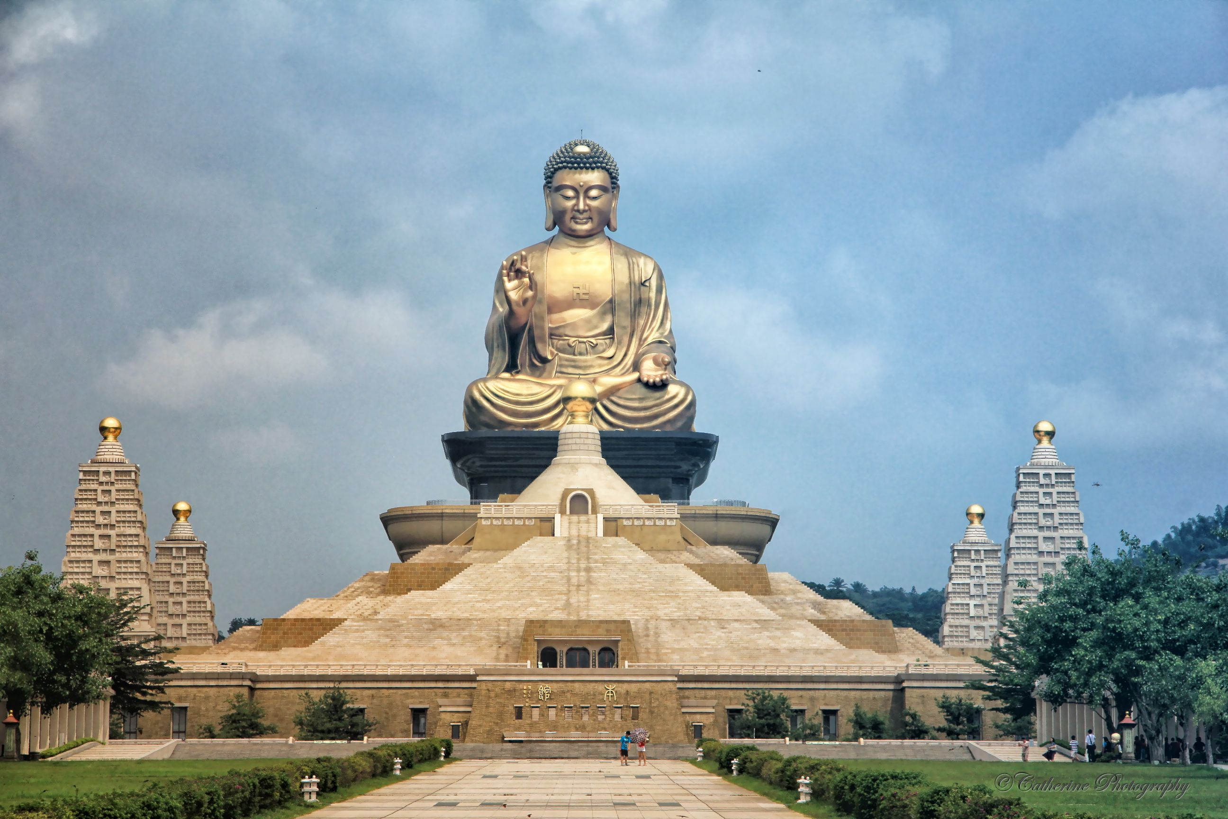

Slide 9
Psychodrama
A professional practice based on the therapy, philosophy, and methodology developed by J.L. Moreno, M.D. (1889-1974) which used:
Action methods of enactment.
Sociometry.
Group Dynamics.
Role Therapy.
Social Systems analysis to facilitate constructural change in individuals and groups.
The Triadic System:
Psychodrama (Intrapersonal)
Sociometry (Interpersonal)
Group Psychotherapy (Person in a system)

Slide 10
More on Psychodrama
Founder:
J. L. Moreno, M.D., Psychiatrist: (1889-1974)
Founder of Psychodrama and Sociometry and pioneer of Group Psychotherapy
Founder of the International Association of Group Psychotherapy
Key Principles:
Spontaneity and Creativity:
The here and now approach; the power of love and mutual sharing in group life; the possibility of a whole society incorporating these principles.
Diagnostic Tools:
Social Atom
Role Diagram

Slide 12
Moreno Words of the Father

Slide 13
Moreno’s Godhead
The world of humankind cannot maintain itself without a system of values. It is to this end that a new conceptualization of God is called for, and a new conceptualization of God is presented in The Words of the Father, a Godhead for these times.

Slide 14
Psychospiritual Underpinnings of Psychodrama
Unique to Moreno’s theory was its metaphysical the theological underpinnings. In the mid 1930’s when Moreno published his first book, psychology and spirituality were seen as different and separate. Yet Moreno (1972) boldly suggested that individuals are co-creators with God, indicated self-responsibility in what one creates in life and in the world in general. God is not seen as a separate being floating in the sky, but rather as an expression of immanence – the indwelling of the Supreme Being. By this definition all existence and each being is an expression of God.

Slide 15
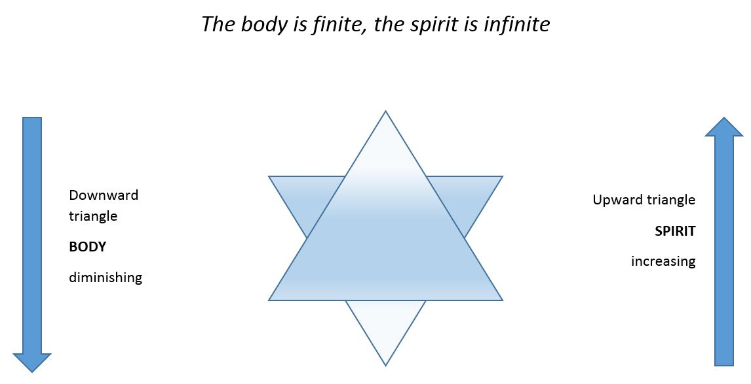
Juliet Batton’s Star Model

Slide 16
Moreno’s Godhead
I AM.
WHETHER OF NOT YOU BELIEVE IN ME,
EVEN IF, IN ALL THE UNIVERSE,
THERE IS NO ONE TO RECOGNIZE ME,
I AM (p. 58)

Slide 17
J.L. Moreno, M.D. 1889-1974
“A truly therapeutic procedure cannot have less an objective than the whole of mankind.”

Slide 18
Ubuntu
Zulu term roughly translated to “human kindness.”
I in you and you in me.
It is an idea from the Southern African region, which means literally, “humanness.” It is often translated as “humanity towards other,” but is commonly used in a more philosophical sense to mean, “The belief in a universal bond of sharing that connects humanity.”

Slide 19
Psychodrama
Psychodramatic treatment is based on Moreno’s view of man as a cosmic, social, and singular individual.
Spontaneity is the human ability that enables us to develop adequate responses to life situations.
Spirit = To infuse energy
Psychodrama is the science which explains the “truth” by dramatic methods.
Each of us are creators possessing the energy to produce a “new response to an old situation.”
“A truly therapeutic procedure which does not have less an objective than the whole of mankind.”

Slide 20
Psychodrama and Spirituality
Moreno provided the operational line between the person and the creator by postulating a new God-idea. The person becomes the creator and participant in life. The person has the responsibility for this existence since he is inseparably connected to the creator. In order to exist meaningfully each person must act out this creativity.
“This we can become not only a part of the creation, but a part of the Creator, as well. The world becomes our world, the world of our choice, the world of our creation”.
Moreno, Words of the Father, p. xv.

Slide 21
Psychodrama and Spirituality
“None of my inspirations and pronouncements, however, have been more severely criticized, misunderstood, and ridiculed, than the idea that I proclaimed myself as God, as the Father of my mother and father, or my ancestors, of everything which lives… But it is the I that matters; it is the I which was provocative and new. And it is the I-God with whom we are all connected. It is the I which becomes the We.”
Moreno, Psychodrama Volume III, p. 21.

Slide 22
Moreno’s Godhead
I AM NOT YOUR GOD,
I AM GOD.
I AM NOT THIS NATION’S GOD
NOR THAT NATION’S GOD,
I AM GOD.
I AM NOT THE GOD OF THIS CLASS
OR OF THAT CLASS,
I AM GOD (p. 55)

Slide 24
Moreno’s Godhead
Moreno is not presenting us with a new or different God. God does not change; the human conceptualization of God changes according to the times and the needs of humanity. Moreno presents us with a new concept of God. While there have been religions with a god and religions without a god, Moreno wrote, this is the first time that there has been a concept of a God without a religion. The Godhead depicted here needs no church to introduce him and he does not favor any particular race over any other, any system of religious belief over others, any country over another.

Slide 25
Moreno’s Godhead
He communicates just as easily to those who have never been inside a church, temple, or mosque as to the devout who never miss a service, to theists and atheists alike. He needs no prophets. He interprets himself. He is not outside the universe. He is present here and now. A problem with previous notions of God, Moreno suggests, has arisen in the past when those individuals who have heard God have not understood that God passes through them. They, in turn, have deluded others into confusing them with the idea of God.

Slide 26
Psychospiritual Underpinnings of Psychodrama
Furthermore, Moreno’s suggestion that God is immanent, creative, and the supreme co-creator promotes respect and honor between group members. To see the light of God in each group member and to gain an understanding of the universal struggles of all human beings discourages what Moreno (1972) call the “cultural conserve” while encouraging conscious living in each and every moment. Such spiritual views promote a broad vision of individual struggles and experiences – both for oneself and for others. As a result, one’s impulse to judge or criticize diminishes (Moreno, 1972).

Slide 27
Canon of creativity
W
>>>
W
>>>
C
>
<
>>
S
X
CC
W
<<<
W
<<<

Slide 28
Moreno
“We can find a connection with God from a slightly different perspective. God represents all spontaneity-creativity that he has shared with all his creations. We, of course, are included. When we are in touch with our own spontaneity, we are in touch with God.”

Slide 29
Spontaneity
An adequate response to a new situation or a new response to an old situation.

Slide 30
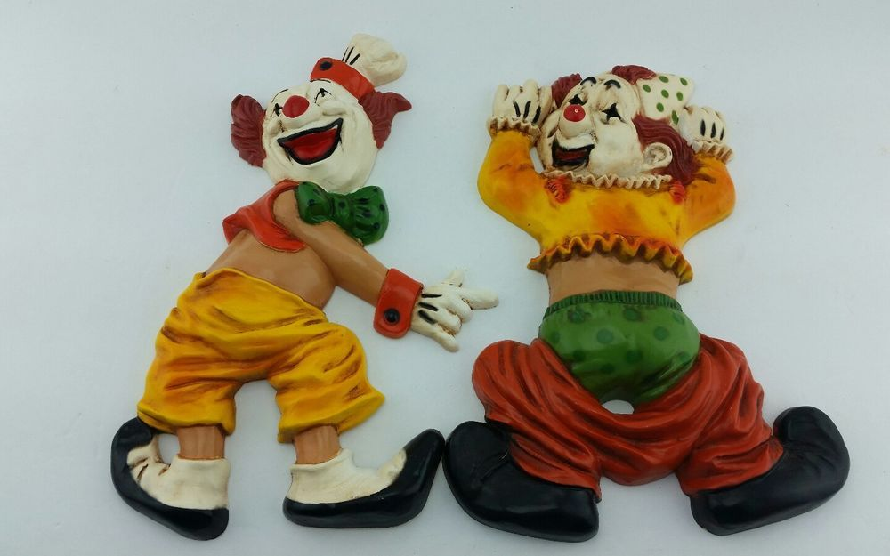
Clowns

Slide 31
Psychospiritual Underpinnings of Psychodrama
Moreno’s philosophical and theological views greatly influenced the theory and practice of psychodrama. Theoretically, psychodrama is a holistic form of therapy addressing implicit subconscious concepts of God. For Moreno, part of living consciously is addressing individual views about god and spirituality. Moreover, Moreno saw spirituality as essential to clinical activities. This includes examining fundamental existential concerns universal to the human experience such as choice, freedom, self-determination, and the responsibility to shape one’s life.

Slide 32
More on Psychodrama (cont.)
Quote which characterizes J.L. Moreno’s philosophy:
“A meeting of two: Eye to Eye, Face to Face.
And when you are near I will tear your eyes out, and place them instead of mine,
And you will tear my eyes out, and will place them instead of yours;
Then I will look at you with your eyes, and you will look at me with mine.”
Purpose of Psychodrama:
A return to the natural spontaneous being by the simple method of being able to express oneself freely, without being held back by individual inhibitions or social restraints.

Slide 33
Psychospiritual Underpinnings of Psychodrama
Therapeutically, psychodrama creates encounters in which individuals have the opportunity to discover the world through another’s perceptions. Truly one can participate in spiritual dialogue. In psychodrama, the protagonist can encounter God by using fellow participants to engage in spontaneous conversation and role reversal. Taking on the role of a higher power, an individual will find oneself spontaneously coming up with individualized and surprisingly meaningful answer to long-asked existential questions.

Slide 34
Encounter

Slide 36
Psychodrama and Spirituality
“It is no longer the master, the great priest or the great therapist who embodies God. The image of God can take form and embodiment through every man—the epileptic, the schizophrenic, the prostitute, the poor and the rejected. They all can at any time step upon the stage, when the moment of inspiration comes, and give their version of the meaning which the universe has for them.”
Moreno, Psychodrama Volume III, p. 21

Slide 37
Be Spontaneous
This also means:
“Be responsible for creating a world around you. Be aware that you share the universe with a million creative gods.”
World of Illusion
or
World of Reality
Need to bridge both to live a spontaneous, creative life.
Total world of fantasy = Psychotic disorder
Total world of reality = Neurotic disorder
Psychodrama: deals with illusion and reality.

Slide 38
Psychodrama and Spirituality
The God-idea then is alive and functioning in each person’s spontaneity and creativity. Each person is no longer to be viewed as a “re-creator” of the past, passive receptacles of life experience or environment. Each of us are creators, possessing the energy to produce a new response to an old situation.
“I try to give them the courage to dream again. I teach the people to play God.”
Moreno, Psychodrama Volume I, (Beacon House, Inc., Beacon, New York, 1972), p. 6.

Slide 39
Creativity
The use of the imagination or original ideas

Slide 41
Intuition
The ability to acquire knowledge without inference or the use of conscious reasoning.
“Intuition is the long-lost juice of life.”

Slide 42
Three Phases of Creation
The creative process is an identical twin to the intuitive process.

Slide 43
The Three Kinds of Mind
Your intuitive ability increases when your world view supports growth, connectedness, and trust.

Slide 44
Thomas Moore
“The stuff that comes from a child, however, is not science, logic, or mechanical skills. It is soul stuff. It is imagination, heart, and creativity. It is spirit and vision. An education person is someone whose innate being has been led out, enticed and appreciated. One of the joys of working with the soul is that ignorance is not evil and mistakes are paths towards beauty.
But we all know that gentleness requires deep-seated strength and security. One the insecure become aggressive. Soul education requires imagination not force.

Slide 45
Moreno
“Therefore the world which a man finds at his birth is a world which millions of his fellow-beings have aided God in creating. It is not a world imposed by a tyrant—a God dictator. It is a world in which each man can help to create and into which he can project his own dreams.”

Slide 46
Moreno
“The Psychodramatic answer to the claim that God is dead is that he can easily be restored to life. Following the example of Christ, we have given him and can give him new life, but not in the form that our ancestors cherished. We have replaced the dead God by the millions of people who can embody God in their own person.”

Slide 47
The Three Kinds of Mind

Slide 48
Psychospiritual Underpinnings of Psychodrama
Additionally, Moreno (1972) suggested that God acts within the creativity of each individual person. Such creativity and spontaneity is believed to be a connection with God as an expression of transpersonal identification. Rather than being a moralistic God, Moreno proposed that God encourages aesthetic values which highlight pleasure in creativity, discover, and celebration of life. Therefore God does not act in the role of a judge, but is instead one who invites caring, compassion, and the achievement of our full potential (Moreno, 1972).

Slide 49
Moreno’s Godhead
Father God of the Hebrew = He God
Christian God of Love = Thou God
To be in touch with God is to be in touch with one’s spontaneity and creativity = I God
The Three Philosophical Cornerstones of Psychodrama Therapy:
Godhead => Spontaneity / Creativity of each individual
Sociometry => Method of observation. Basic social structure of all human interactions.
Psychodrama => Co-creator / Actor provides action methods and role constructs

Slide 50
WARNING!
Do not become a zoomatron!
Be spontaneous to create a better world for all mankind.
Thank you!
谢谢

